Slide 1
Practical – 8
Machine Learning

Slide 2

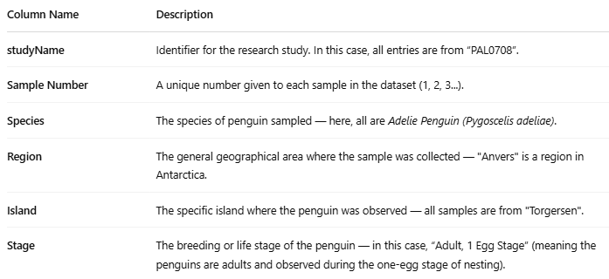
Dataset:-
Aim:- Given a penguin dataset, generate rules using a suitable algorithm.

Slide 3
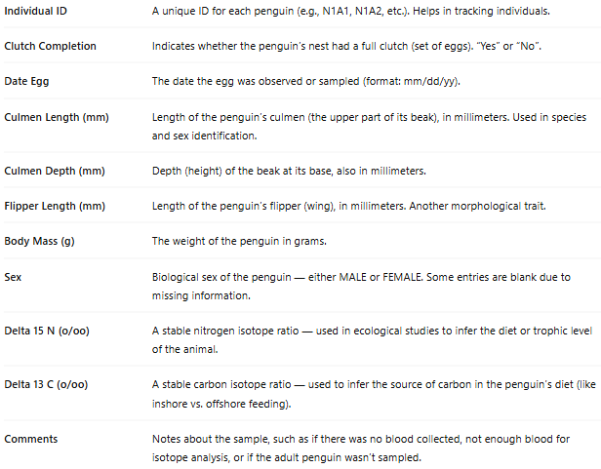

Slide 4
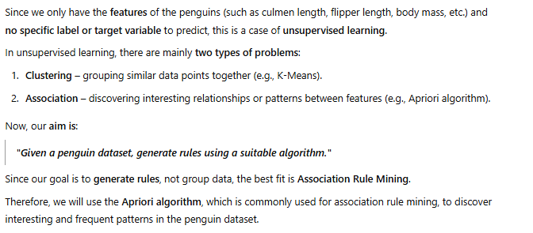

Slide 5

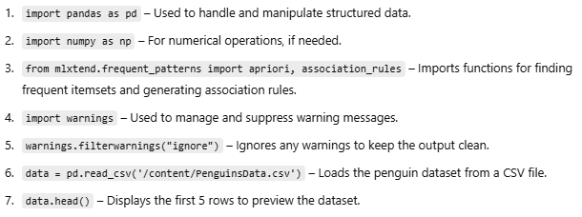

Slide 6


Slide 7

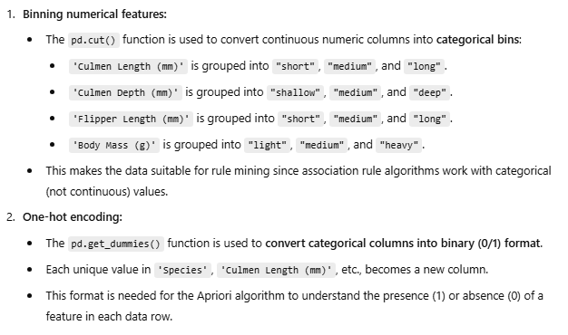

Slide 8

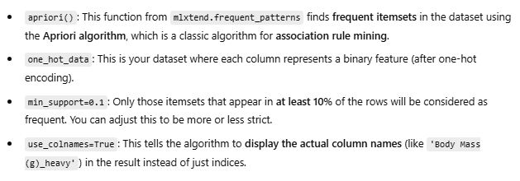

Slide 9

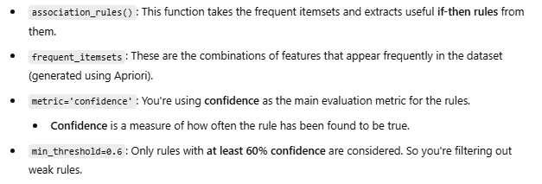

Slide 10





Slide 11





